Slide 1
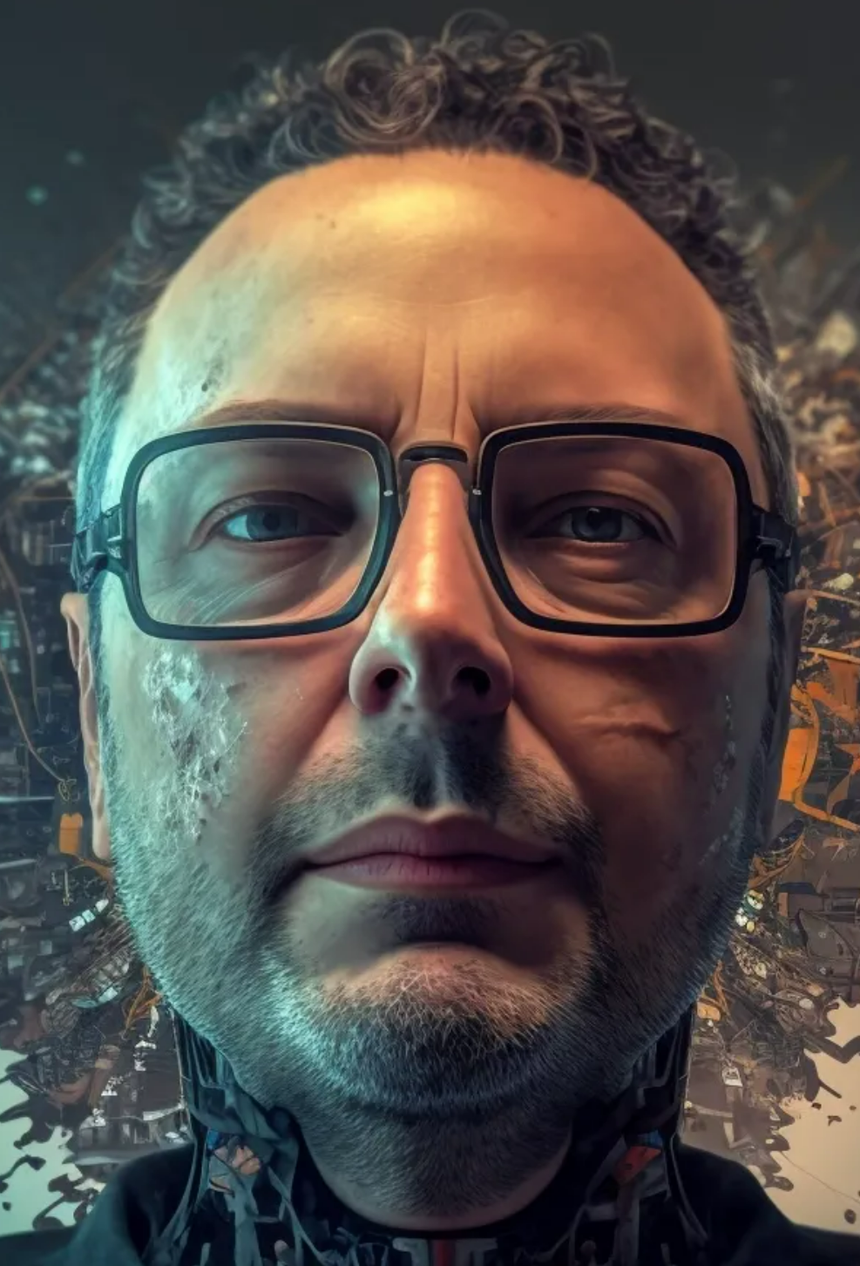
deep generative models
midjourney bot (2023)

Slide 2
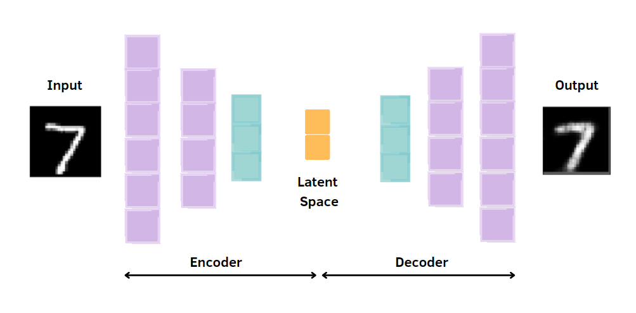
autoencoder
In an autoencoder the latent variable is not regularized, picking a random latent variable can generate garbage output.

Slide 3
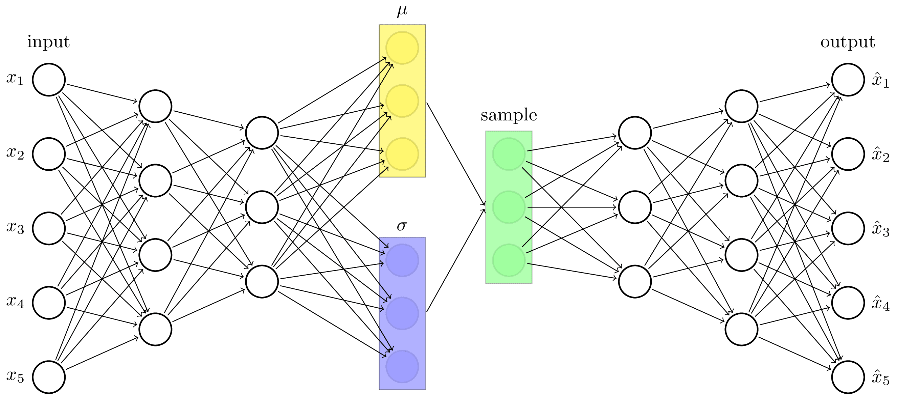
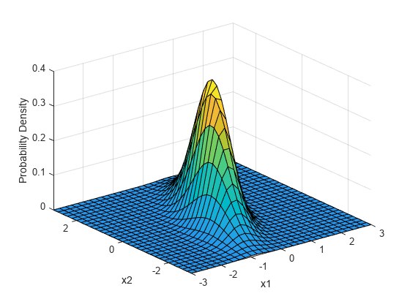
variational autoencoder
In an autoencoder the latent variable is not regularized, picking a random latent variable can generate garbage output.
A variational autoencoder solves this by mapping the input image to a distribution in the latent space, rather than a single point.

Slide 4
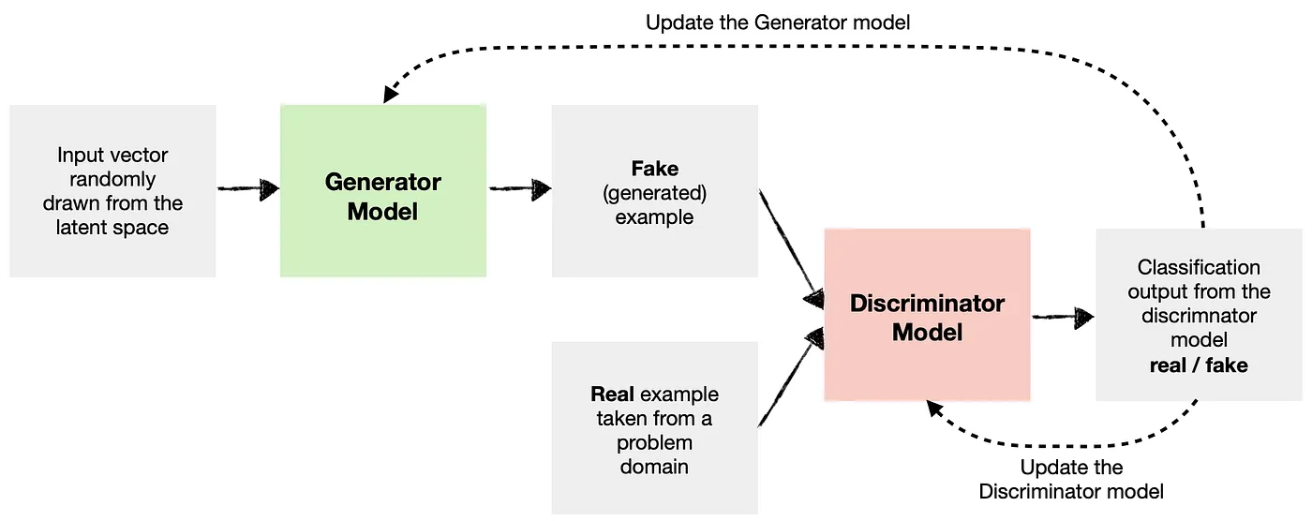
generative adversarial network (GAN)
The generator learns to generate new data (i.e., fake data) similar to that of the problem domain.
The discriminator learns to identify whether the provided example is fake (comes from a generator ) or real (comes from the actual data domain).
Both the generator and the discriminator are trained together.
.

Slide 5
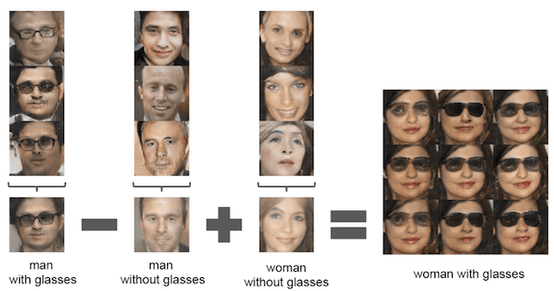
generative adversarial networks

Slide 6
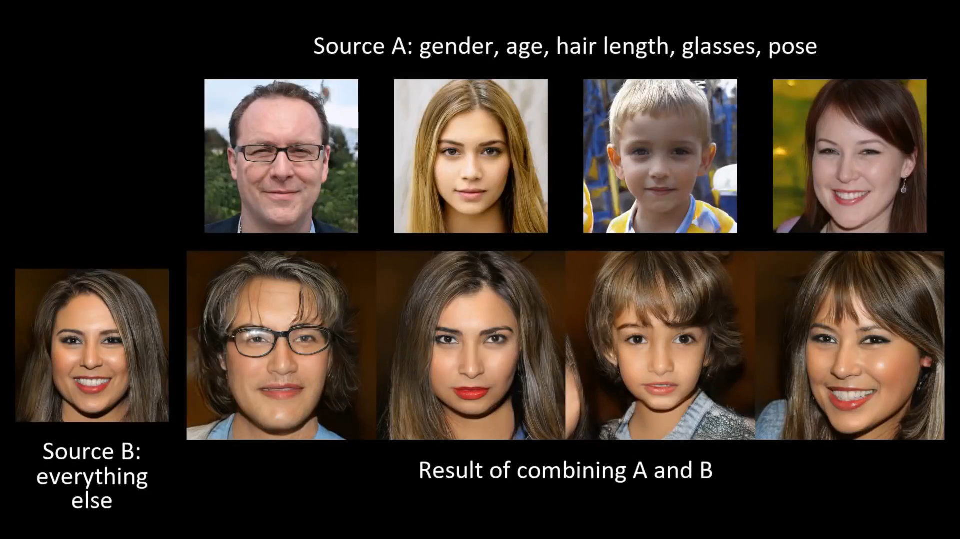
generative adversarial networks
Karras et al. IEEE Conference on Computer Vision and Pattern Recognition (2019)

Slide 7
generative adversarial networks
https://this-person-does-not-exist.com/
.

Slide 8
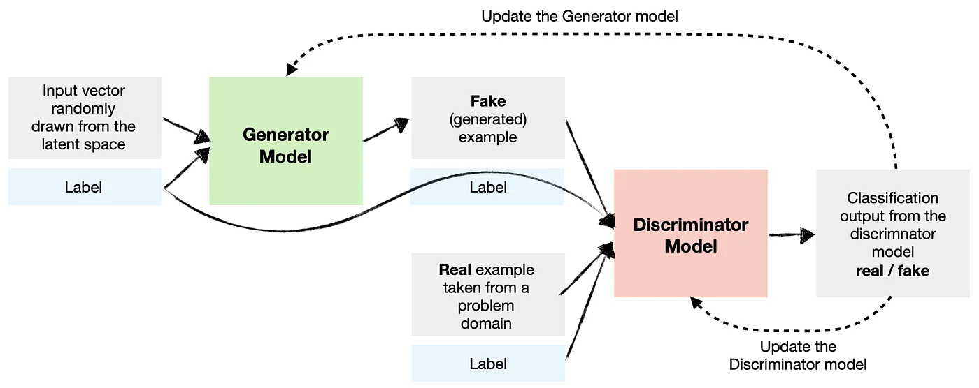
conditional GAN
A conditional GAN conditions both the generator and the discriminator so they know which type they are dealing with.

Slide 9
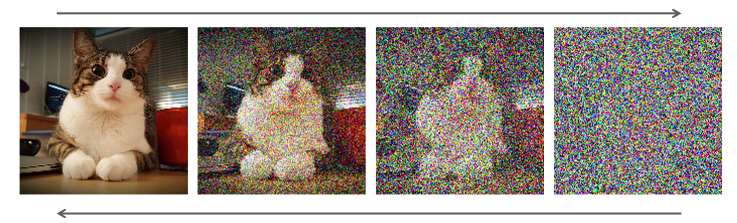
diffusion model
A diffusion model learns to denoise images blurred with Gaussian noise by learning to reverse the diffusion process.

Slide 10
diffusion model
A diffusion model learns to denoise images blurred with Gaussian noise by learning to reverse the diffusion process.

Slide 11
diffusion model
RF Diffusion outperforms existing protein design methods across a broad range of problems, including topology-constrained protein monomer design, protein binder design, symmetric oligomer design, enzyme active site scaffolding, and symmetric motif scaffolding for therapeutic and metal-binding protein design.
https://www.bakerlab.org/2023/03/30/rf-diffusion-now-free-and-open-source/

Slide 12
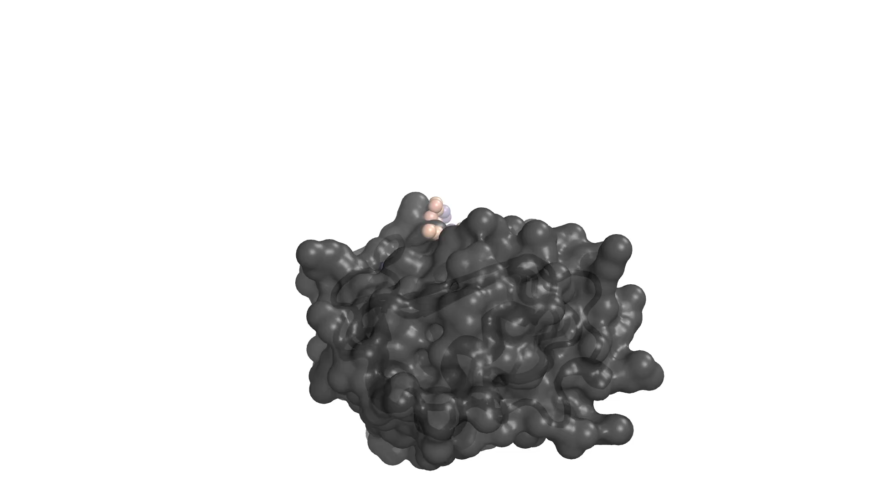
diffusion model
Here RF Diffusion generates a novel protein that binds to the insulin receptor.
https://www.bakerlab.org/2023/03/30/rf-diffusion-now-free-and-open-source/

